Slide 1
Analysis of Family Planning Data
-Bipul Kumar
-2014CS50282

Slide 2
Why
Policy makers require the deeper understanding about the demographics of population before creating policies.
They are also need to be aware of current impact of their previous policies.
but due to various constraints such as time and effort, they couldn’t.
So as a data analyst, it is our job to gather evidence of policy impact and offer them in easy to understand terms.
The evidence should be accessible on web interface.
Also learn from data to forecast models by trying to predict upcoming situation down the few years.

Slide 3
Our Job
Gather Evidence:
Gather the evidence of the impact of family planning
Present:
Make the evidences easily accessible by web interface
Explore:
Explore factors which best explain the variations in policy impact across districts

Slide 4
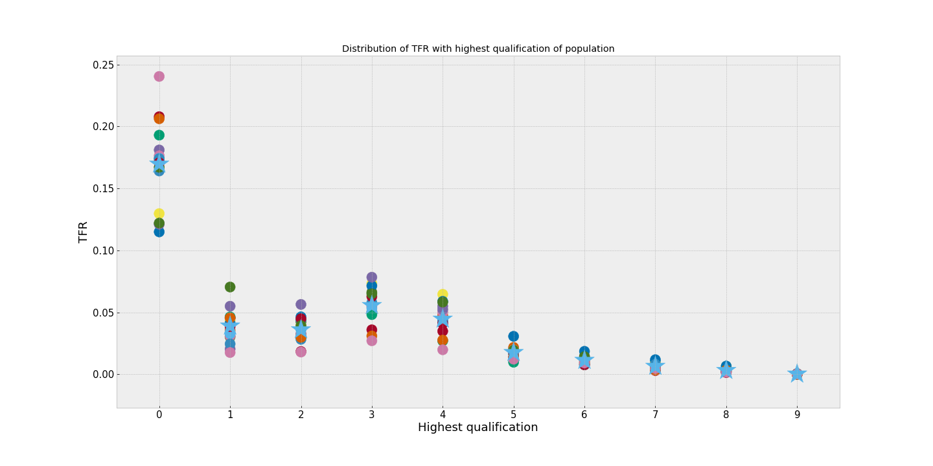
Results so far
Log graph between TFR and Highest education level of population. 0-complete illiterate. 1-means literate but below primary (Didn’t completed till class 5th)
Illiterates have tfr 5 times of tfr of non primary educated women.

Slide 5
Contraceptive Methods vs Demographic Variables
Results:

Slide 6
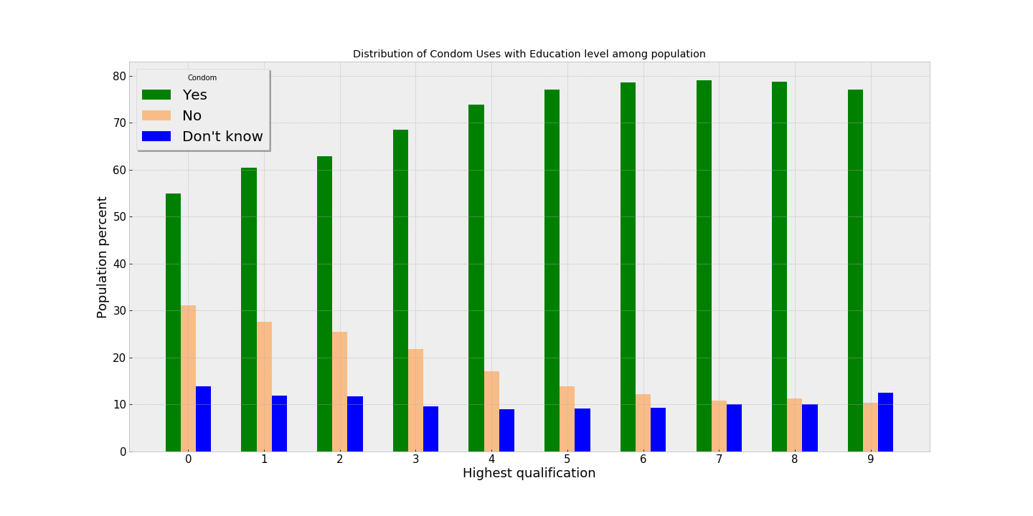
Condom Use vs Education level
The awareness and preference of condoms increases as population gets more educated.
Condom preference varies from only 50% of illiterate women to 80% of graduates and above educated women.

Slide 7
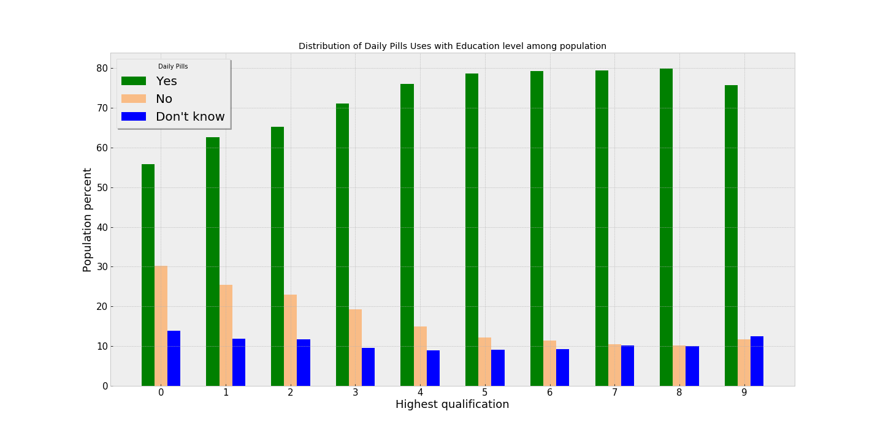
Contraceptive Pills vs Education level
More fraction of women prefers Pills than Condoms.
This is specifically visible in case of women who could finish only Senior Secondary education.
But not much in case of illiterate women.

Slide 8
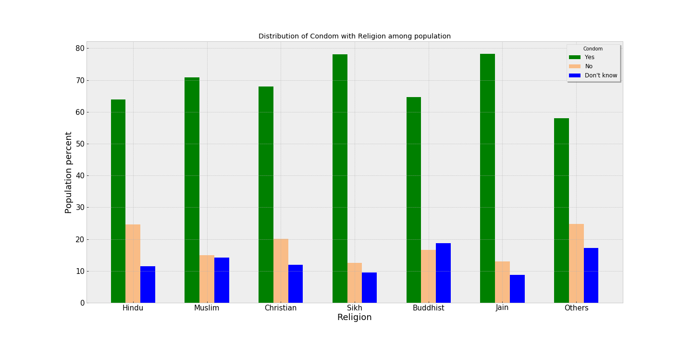
Condom Use vs Religion
Condoms is most prevalent in Sikh and Jain.
Close to 20% of Buddhist are not aware of condoms.
25% Hindus don't use condom.
For those who don't use it, it is possible that they may pursue other means

Slide 9
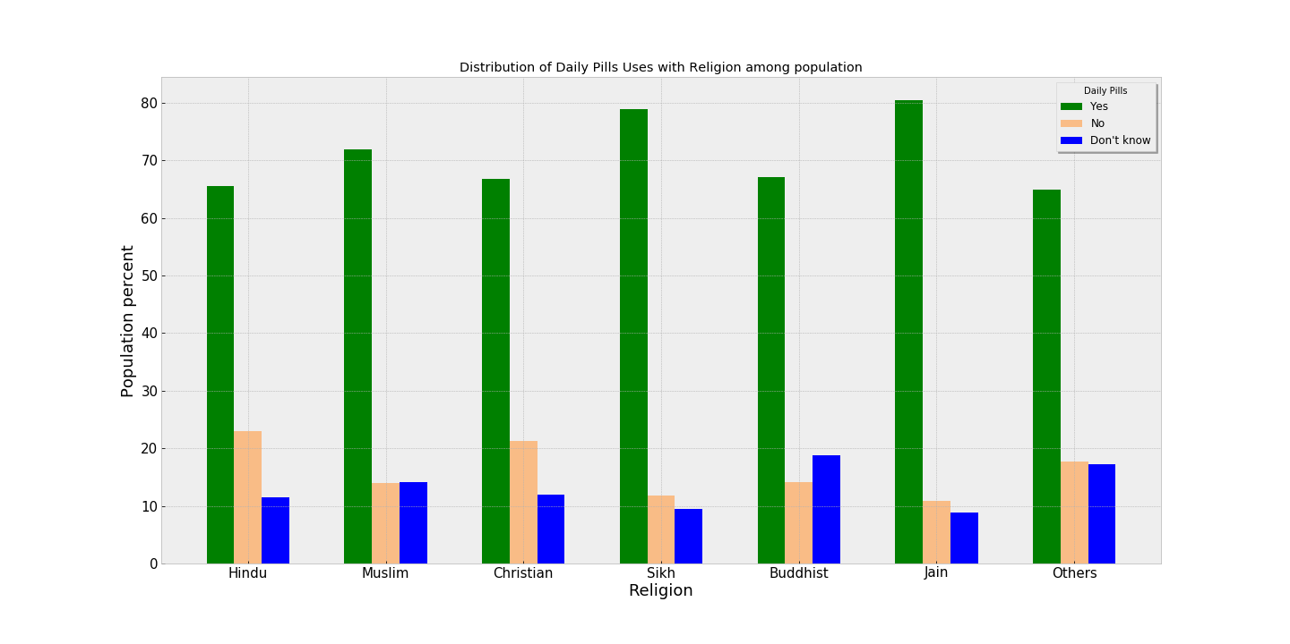
Contraceptive Pills vs Religion
More than 80% Jains women take contraceptive pills daily.
More than 20% of Hindu women don't use pills as a means to contraception.
Not much change appear between condom and pills use. Other religions which include Parsi, Bahai etc prefer contraceptive pills 8-10% more than condoms.

Slide 10
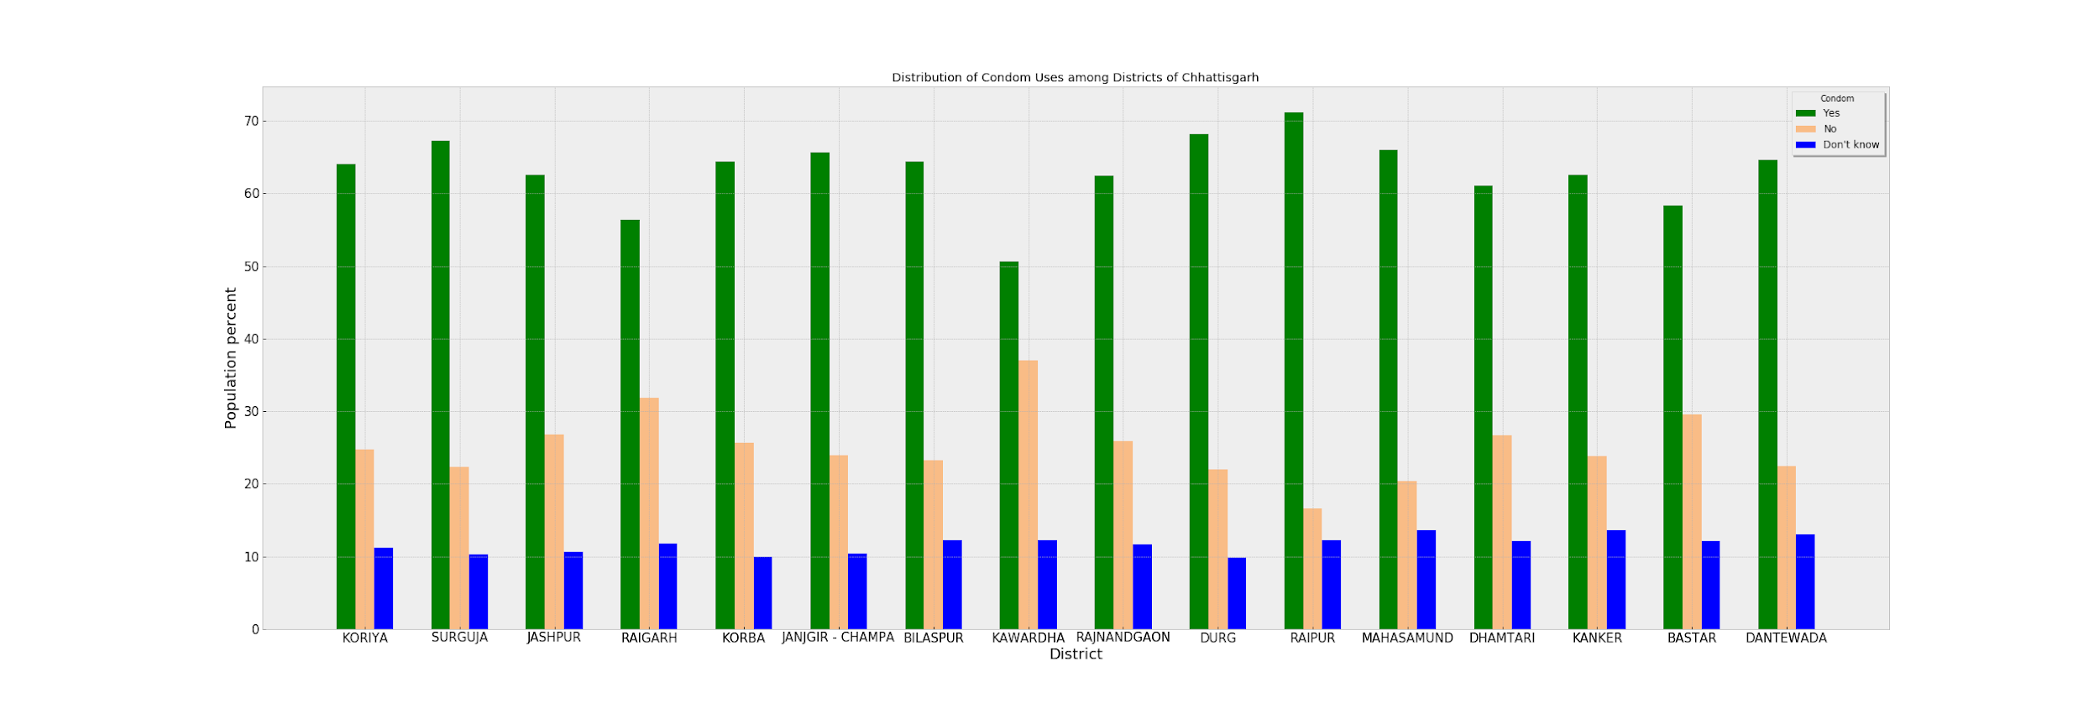
Condom Use vs District
This analysis has been done in Chhattisgarh state.
Raipur has highest % of women preferring condoms as a means of contraception.
Kawardha district has minimum awareness and hence condom is preferred by only 50% of women.

Slide 11
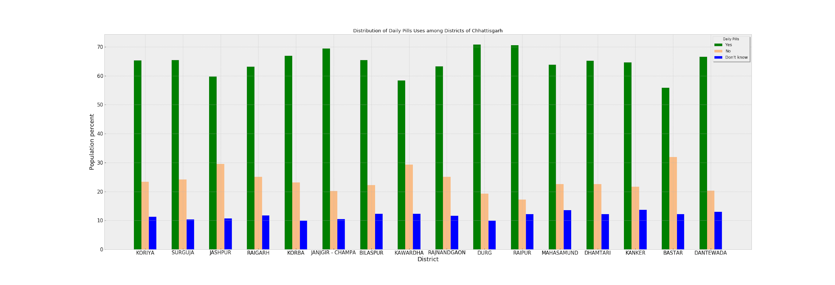
Contraceptive Pills vs District
Raipur and Durg has the highest percentage of women using contraceptive pills.
Durg has highest literacy rate even for women in Chhattisgarh.
Kawardha and Bastar are lagging in pills uses.
More than 30% of women population don't use birth control pills.

Slide 12
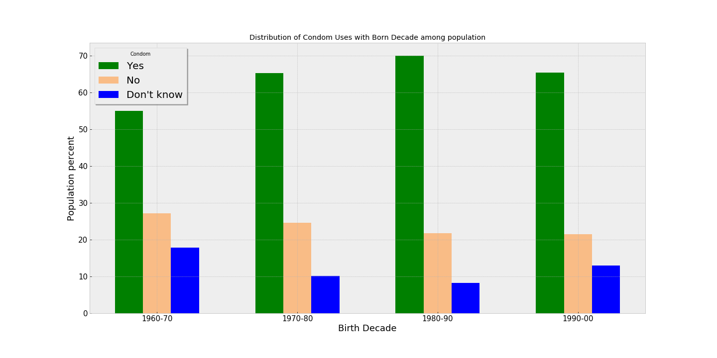
Condom Use vs Born Decade

Slide 13
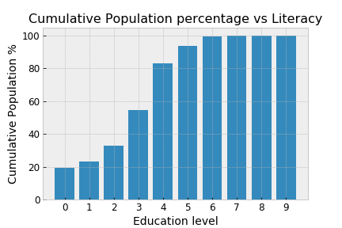
The awareness and preference of modern contraceptive methods increases as population gets more younger.
Condom preference varies from around 50% of women born in 1961-1970 to 70% of women born in 1981-1990.
Condom preference decreases by few % in case of women born in 1991-2000.
This is because such population ranges from age 11 to 21. So they are not much literate.
Illiterate
Literate but didn’t complete 5th.
Literate with primary (5th class)
Literate with middle (8th class)
Literate with secondary (10th)

Slide 14
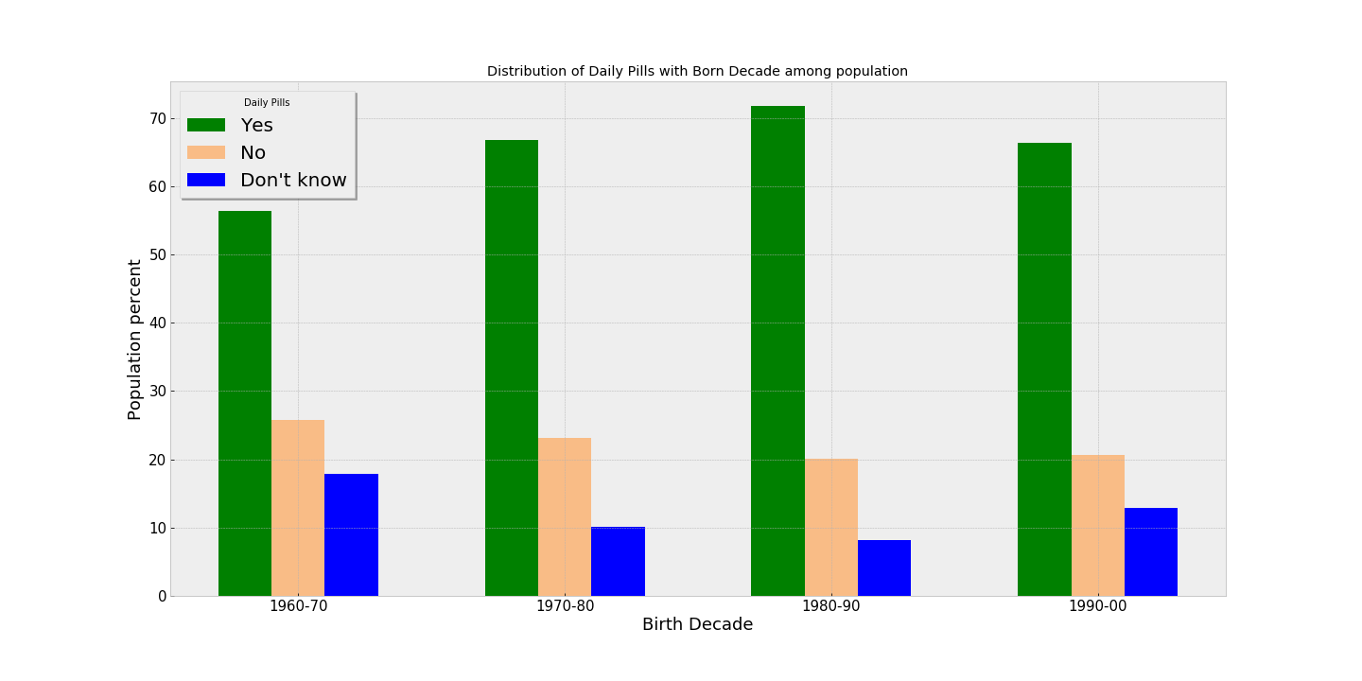
Contraceptive Pills vs Born Decade
Trend is similar to that of condom use

Slide 15
Problem:
We have survey data for women aged 15-49 years.
We want to compare the age of women when she gave birth to first child.
We divided our data into 4 categories: Women born in 1991-2000, 1981-1990, 1971-1980, 1961-1970.
But in this case comparing the age of women of age 11-19 during their first child birth with the age of women of age 20-29 because for the former women only got 20 years for child birth time.

Slide 16
Modelling solutions:
Generate proportional samples and add it to our dataset.
We want to find out situation as if we would have done the survey 10 years ahead for women born in 1971-1980.
Similarly for survey 20 years ahead for women born in 1981-1990 and survey done at 30 years ahead for women born in 1991-2000.

Slide 17
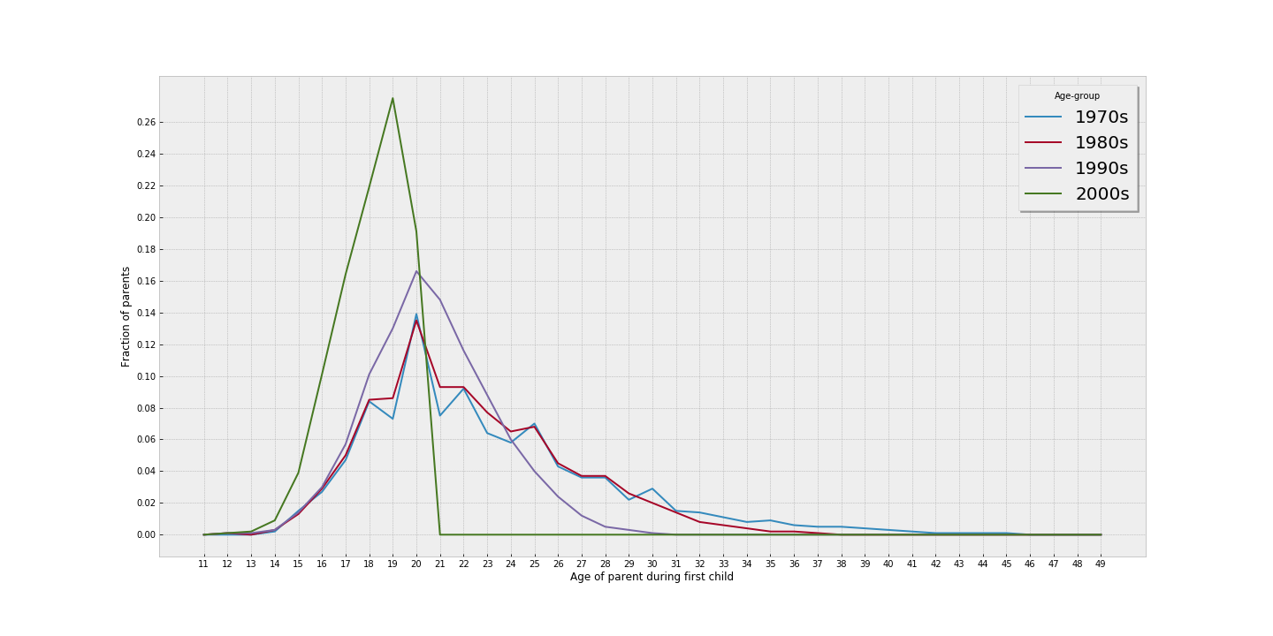
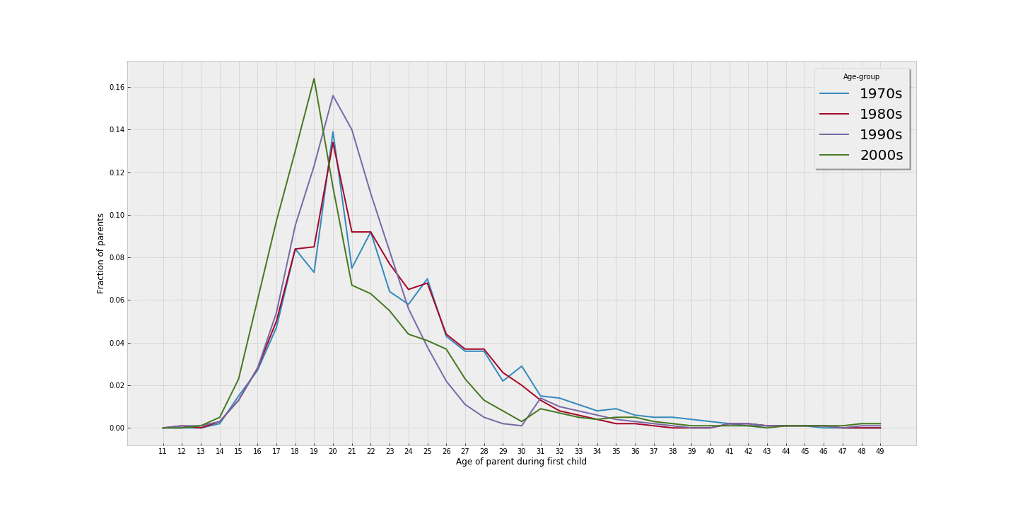

Slide 18
Generate proportional samples and add it to our dataset:
Conclusions:
Most of women became mother between age of 18 and 25 years.
Most women born in 1961-1990 became mother at the age of 20 years.
Women born in year 1991-2000 appear to become mother 1 year earlier.
It seems that modern women are becoming mother earlier. But our dataset is biased in the sense that the women who were interviewed were already mothers. So we could not get later peaks and hence we don’t know the relative fraction of women who would choose to become mother after 19 years.

Slide 19
Modelling solutions:
Only consider samples till mothers of age<20.
We want to find out situation if survey had been done 10 years back for women born in 1981-1990.
Similarly for survey done 20 years back for born in 1971-1980 and survey done 30 years back for women born in 1961-1970.

Slide 20
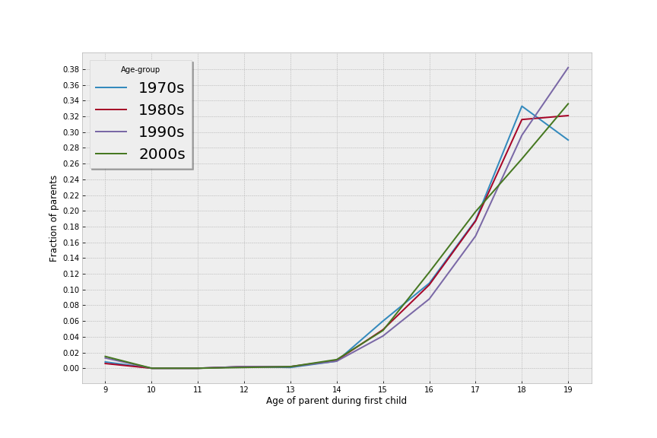
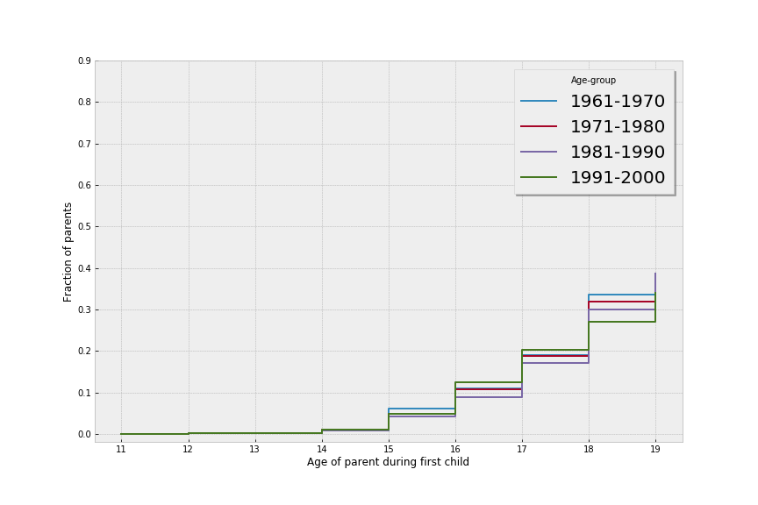

Slide 21
Only consider samples till mothers of age<20:
Conclusions:
Most of the women born in 1961-1970 had their first baby at the age of 18.
But the fraction of such women is decreasing over period. As we can see almost equal fraction of women born in 1971-1980 had their first child at age 18 and age 19.
We can also see for women born in 1981-1990, there is very subtle peak at 18 but eventually most of women prefer 19 as their age of motherhood.
Women born in 1991 onwards prefer to become mother at age 19.

Slide 22
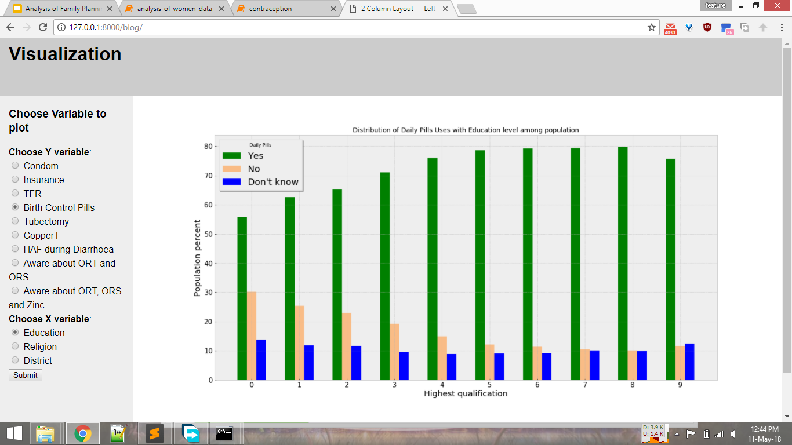

Slide 23
Further Work
Instead of generating samples for a batch of 10 year population at a time, do it for each year and then take its average over 10 years.
Make aesthetic of website better.
Make website accessible to other screen sizes as well as over internet.
Perform explanatory data analysis to get the understanding of the results of mother’s health with demographic variables.

Slide 24
Thank you

